Slide 1
What is a Port Scanner?
Hacking with Python #4

Slide 2
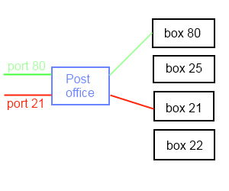
What is a Port?
A virtual slot binded to the Network Interface Card (NIC)
So the receiving device knows what to do with the data.
Eg. HTTP traffic arrives on port 80 is sent to your web browser.

Slide 3
Port Scanner
To discover what machines on a network have ports open.
Generally a Local Area Network (LAN)
Types of scans: Full Connect, ACK, RST, FIN or SYN-ACK
ACK only waits for a response from the port.

Slide 4
Why use one?
Reconnaissance is important
Getting an idea of a network and how it’s setup can prove quite useful.
Knowing what ports may be open on your own network can inform you of possible vulnerabilities on your network.
If you don’t use a port make sure it’s closed.

Slide 5
NMAP
Allows for more complex scans
Made with C and Lua
Python NMAP module exists
We will use this in a later tutorial
(Already comes default with Kali and Backtrack)

Slide 6
Next
Basic Port Scanner
Feel Free to leave questions in the comments I’ll try to answer all of them.

